Slide 1

Welcome to join Harbor Community Conference Call
06:00-07:00 AM (PDT) /
21:00-22:00 (Beijing Time)
2018/12/26 Wednesday
https://zoom.us/j/734959521
Twitter
Maillist
Slack (slack.cncf.io)
@project_harbor
harbor-users@googlegroups.com
#harbor
#harbor-dev
harbor-dev@googlegroups.com

Slide 2


Slide 3
Agenda
Everything related with community (5 mins)
KubeCon Seattle sharing by Steven Z (10 mins)
V1.8 plan introduction by Daniel J and Steven (25 mins)
Project harborctl updates (10 mins)
Q&A (10 mins)

Slide 4
Agenda
Everything related with community (5 mins)
KubeCon Seattle sharing by Steven Z (10 mins)
V1.8 plan introduction by Daniel J and Steven (25 mins)
Project harborctl updates (10 mins)
Q&A (10 mins)

Slide 5
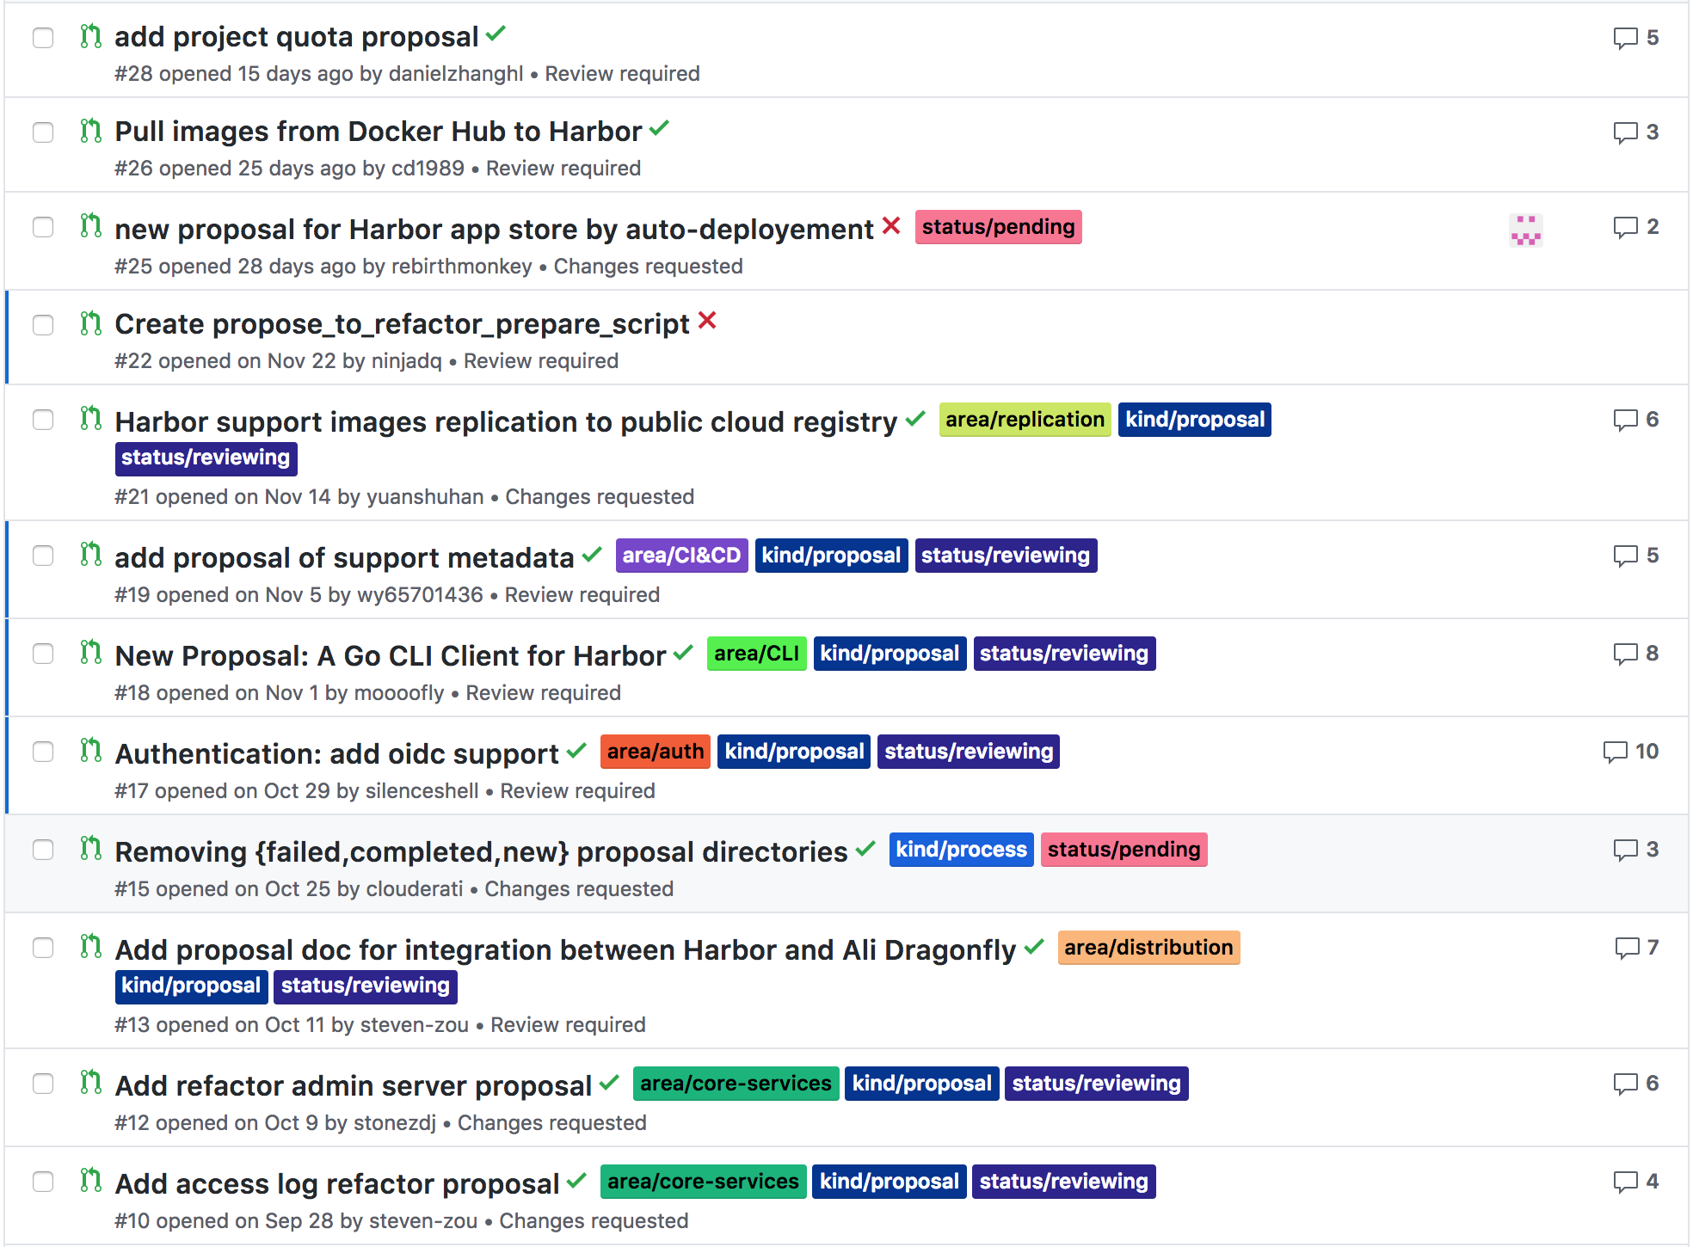
Proposals
Proposals: https://github.com/goharbor/community/pulls

Slide 6
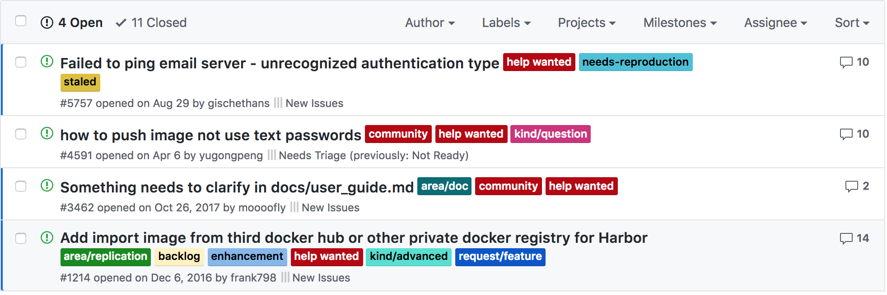
Help wanted
Pick up a `help wanted` issue as a good start to do contributions to Harbor community!

Slide 7
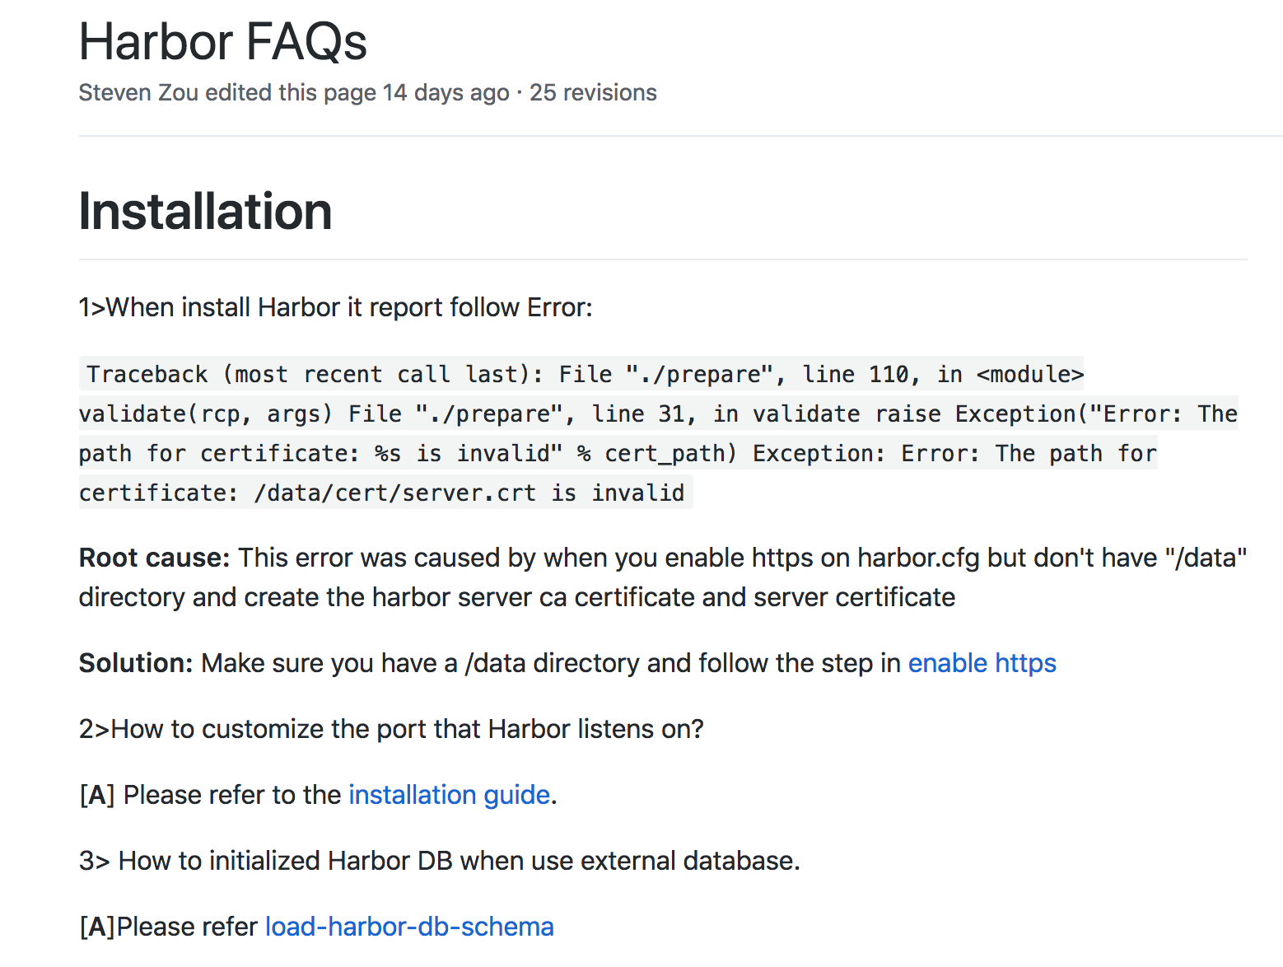
FAQ updates
If you resolve a problem with a solution and that may be benefit to other community members, please add it to the FAQ list!
https://github.com/goharbor/harbor/wiki/Harbor-FAQs

Slide 8
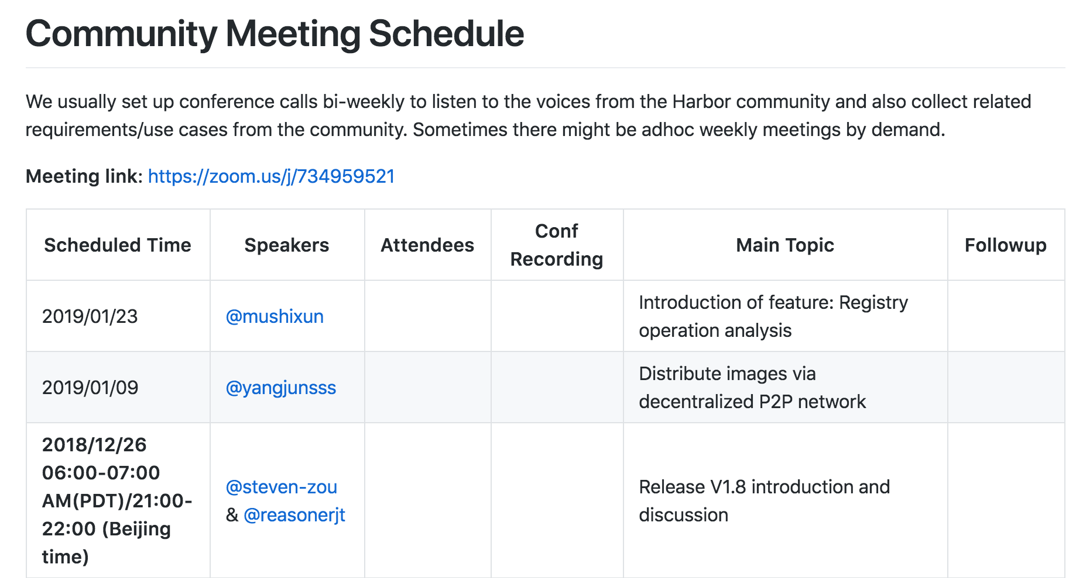
Meeting Topics
If you want to propose meeting topics, go ahead to update the meeting schedule md document and raise PR.
https://github.com/goharbor/community/blob/master/MEETING_SCHEDULE.md

Slide 9
Agenda
Everything related with community (5 mins)
KubeCon Seattle sharing by Steven Z (10 mins)
V1.8 plan introduction by Daniel J and Steven (25 mins)
Project harborctl updates (10 mins)
Q&A (10 mins)

Slide 10
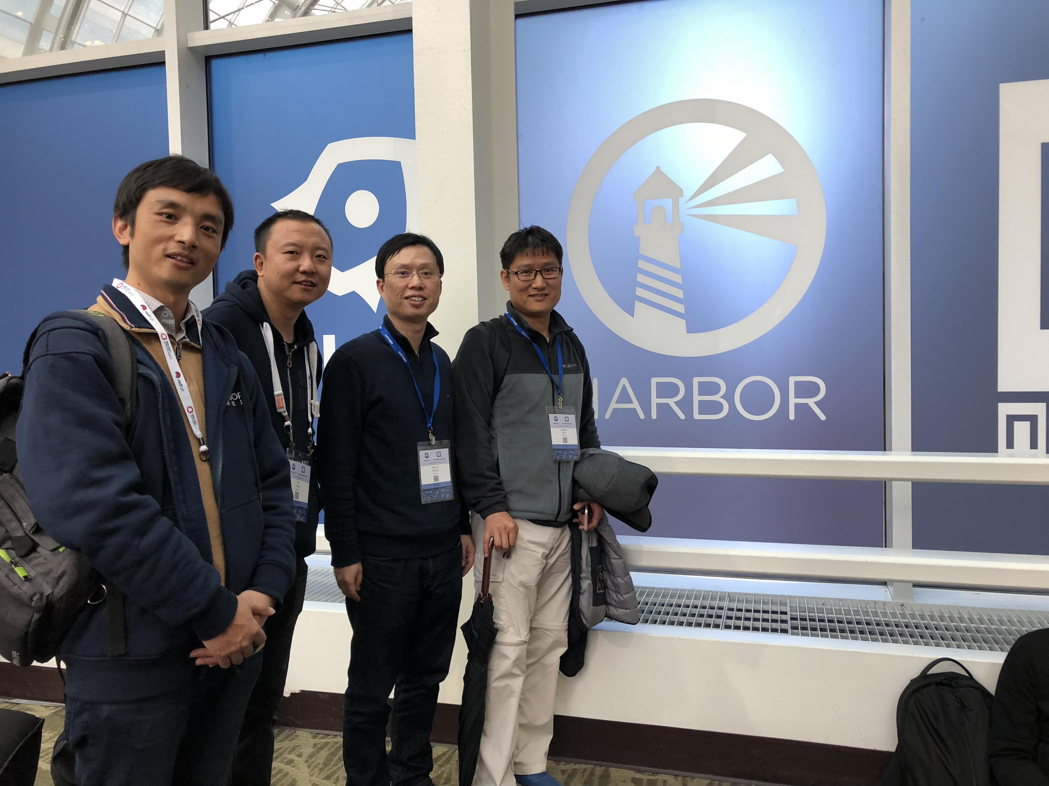
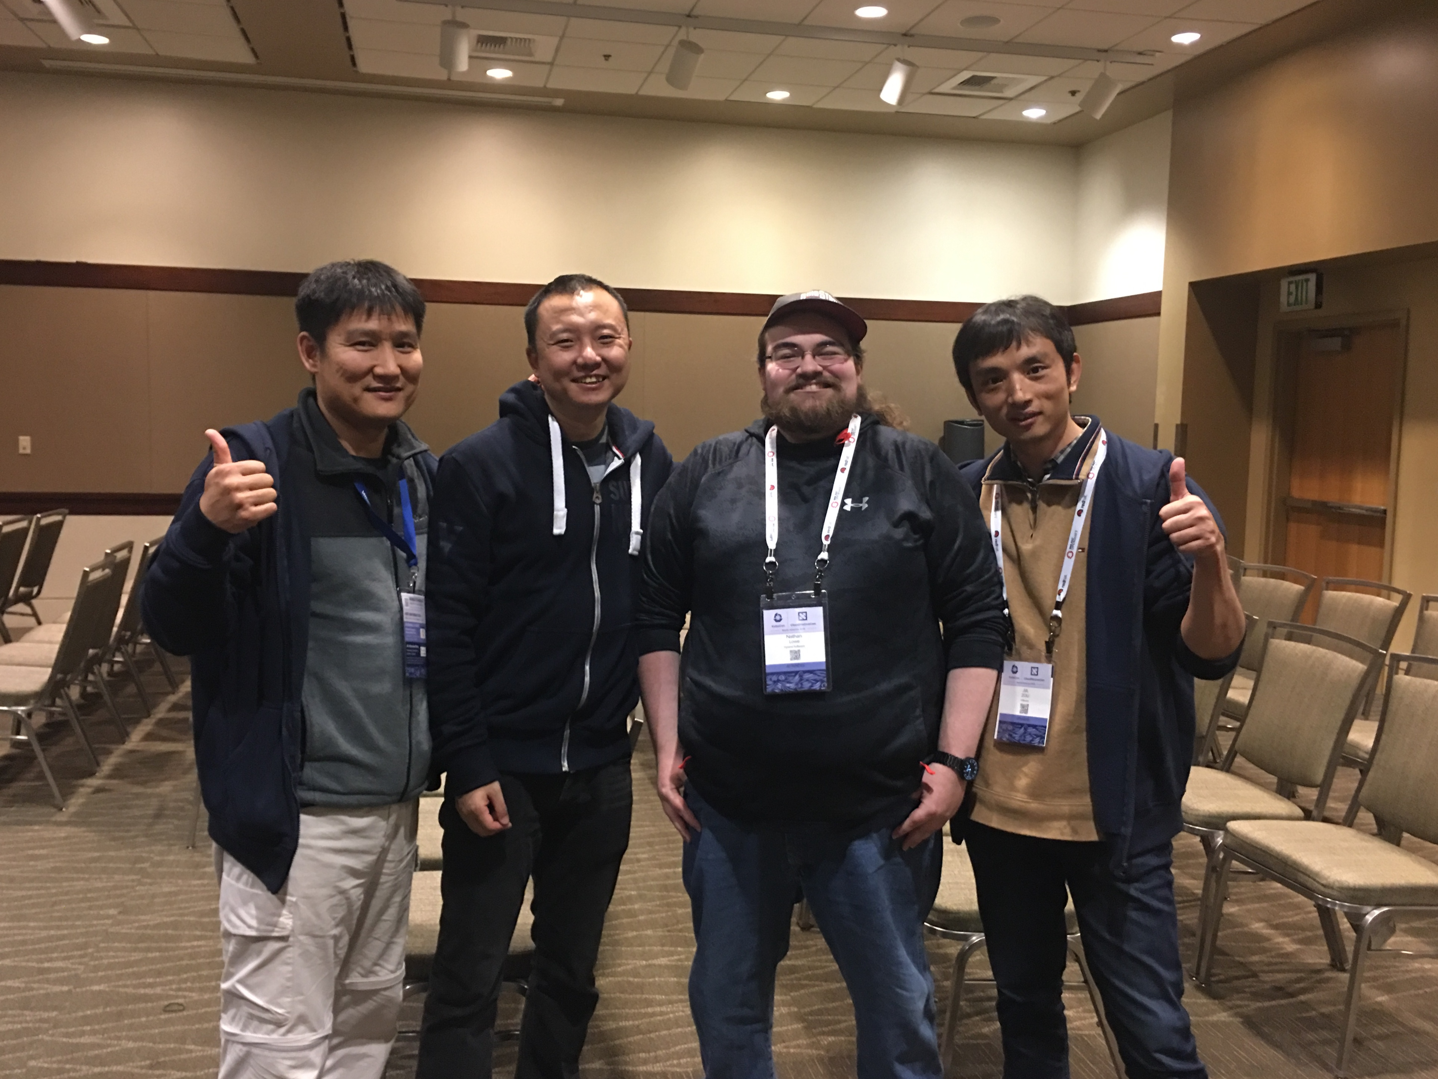
Harbor team @KubeCon Seattle

Slide 11
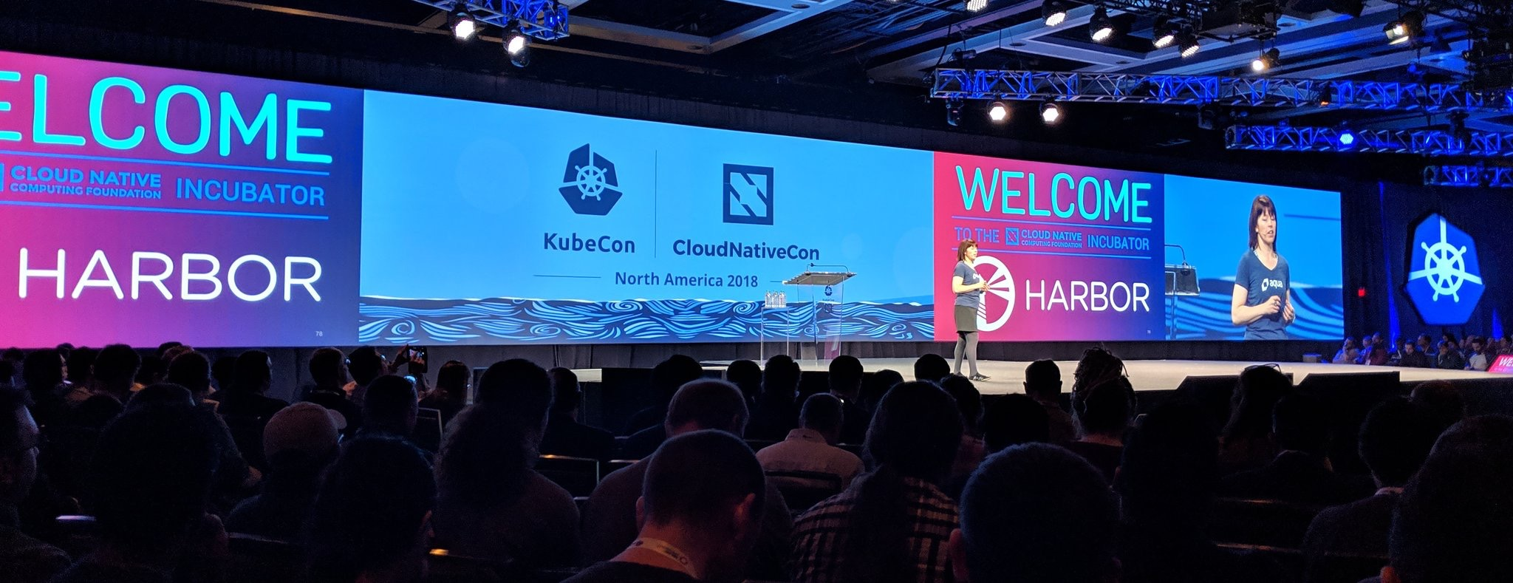
Harbor in Keynotes of KubeCon Seattle

Slide 12
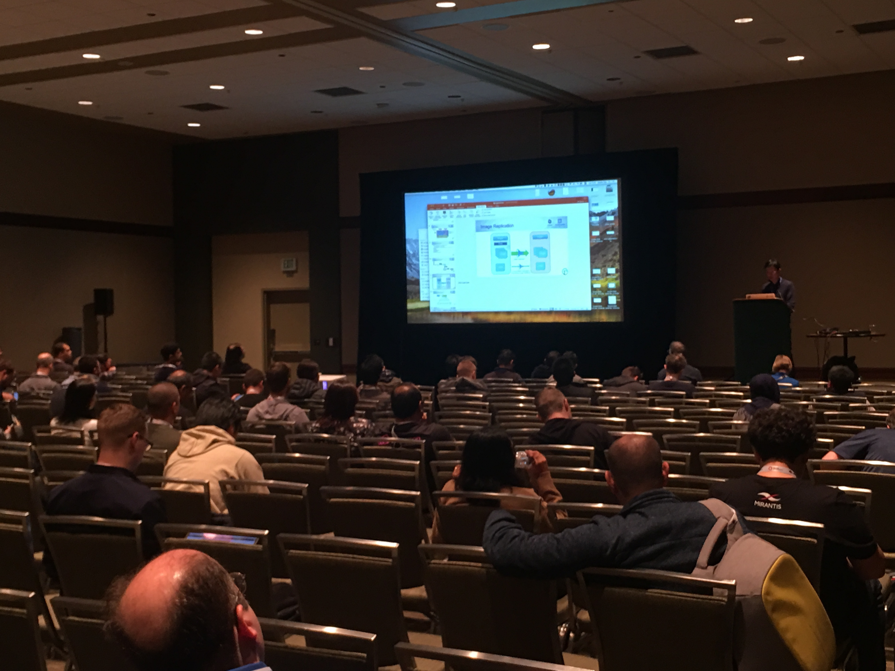
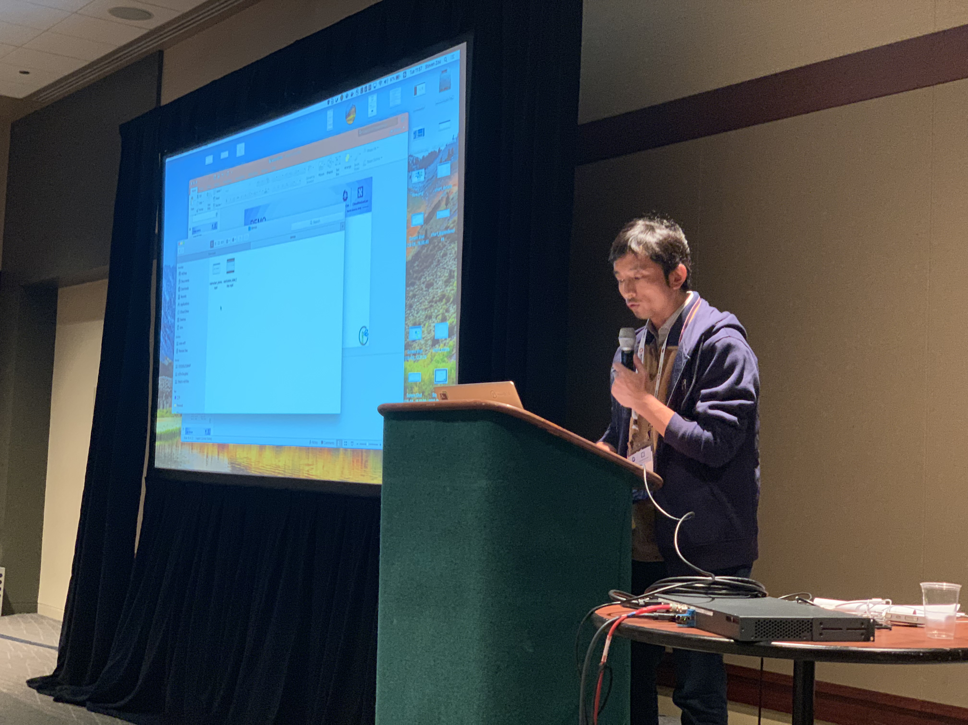
Harbor introduction Session
More than 270 peoples registered this session

Slide 13
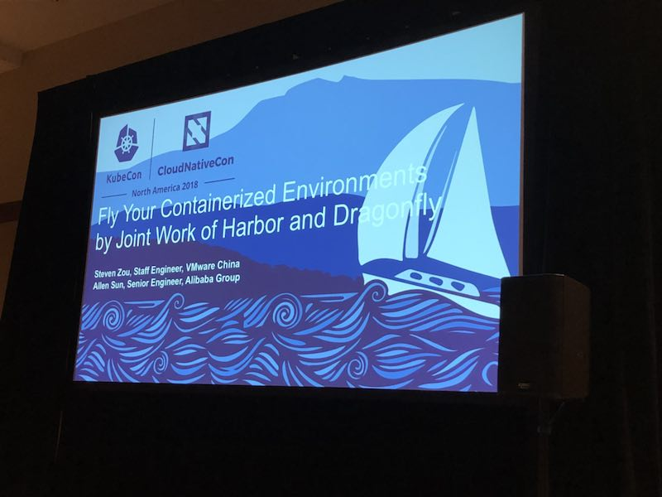
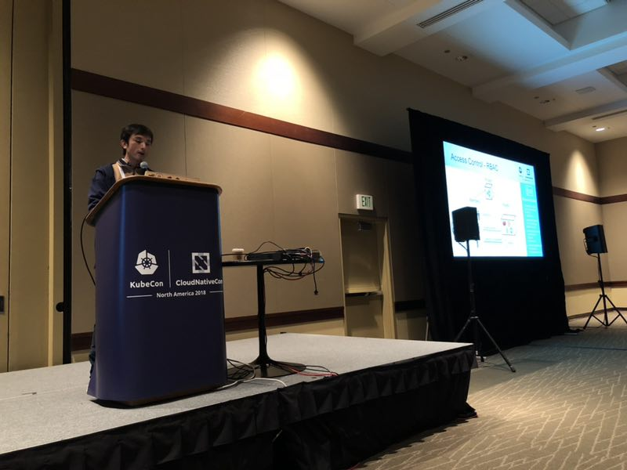
Harbor + Dragonfly session
More than 180 peoples registered this session

Slide 14
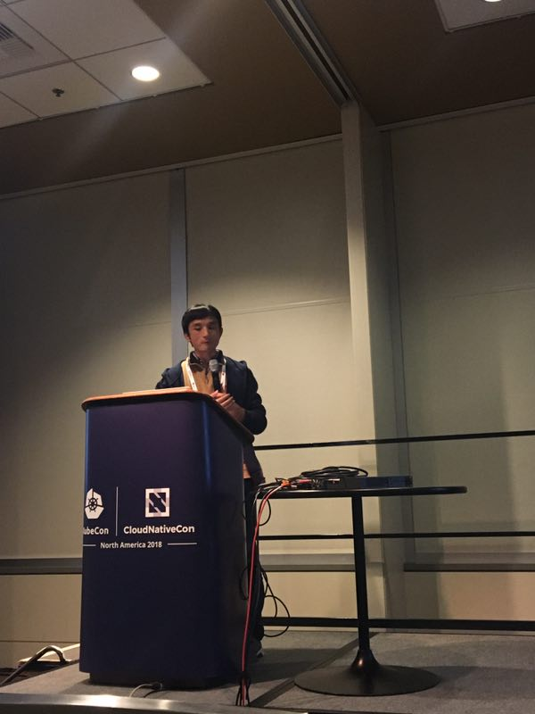
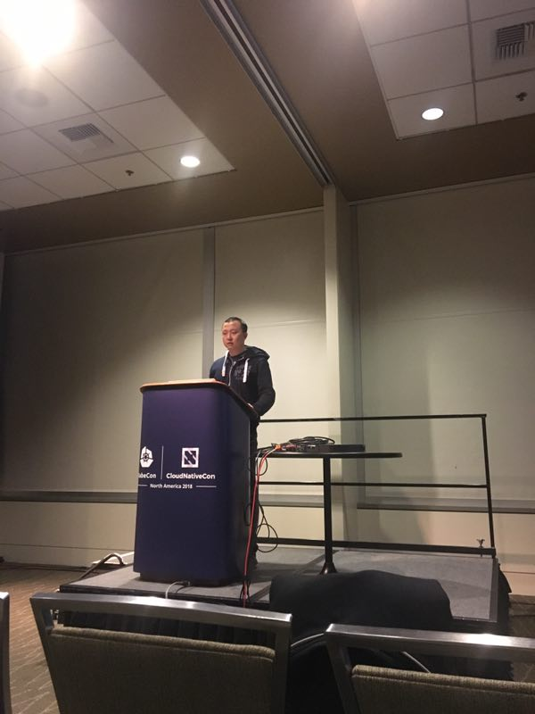
Harbor deep dive session
More than 160 peoples registered this session

Slide 15
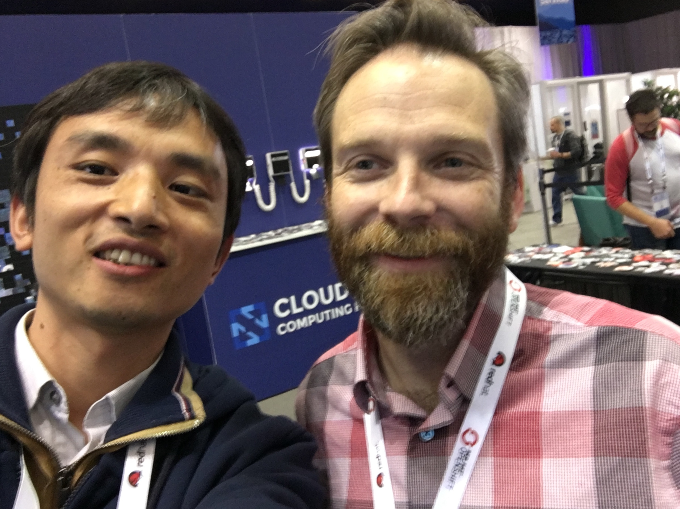
Meet the Helm maintainer
Jason Hansen

Slide 16
Agenda
Everything related with community (5 mins)
KubeCon Seattle sharing by Steven Z (10 mins)
V1.8 plan introduction by Daniel J and Steven Z (25 mins)
Project harborctl updates (10 mins)
Q&A (10 mins)

Slide 17

V1.8 release plan – P0 items
Welcome Daniel Jiang!

Slide 18
V1.8 release plan – P1 items
harborctl by Fei Sun@Liulishuo
webhook/notifications by Ming@Netease
Application package (chart&images) export and import by Rayan@Tencent
replication ng by replication WG
Steven Z & Wenkai yin @VMware
De chen@CaiCloud
Frank Kong @Qihu360
Yuan Lei @Huawei
Ming @Netease

Slide 19
Agenda
Everything related with community (5 mins)
KubeCon Seattle sharing by Steven Z (10 mins)
V1.8 plan introduction by Daniel J and Steven (25 mins)
Project harborctl updates (10 mins)
Q&A (10 mins)

Slide 20
harborcrtl
commands supporting status: https://github.com/moooofly/harborctl/issues/5
the main left part is chart repo related
1st version only contains core functions and NOT contain any complicated functions
Configuration related
Composed commands
statistic
tag retention/clean
Dev based on V1.6 (1.6 will be the 1st supported version)
V1.7 and 1.8 will take into consideration in Harbor V1.8 release timeline

Slide 21
harborcrtl
Call for more contributors to work on this project
If you have interests on this great project, please contact
Fei Sun (moooofly)
Steven Z (steven-zou)

Slide 22
Topics?
Any topics to discuss here?

Slide 23
Meeting minutes
Meeting is recorded and the recording link will be updated to the meeting schedule doc later: https://github.com/goharbor/community/blob/master/MEETING_SCHEDULE.md
The meeting slides will be uploaded to the community repo https://github.com/goharbor/community and put under the ‘conf-calls’ folder.

